Slide 1
Time domain and Frequency domain representations
By S. Rohit

Slide 2
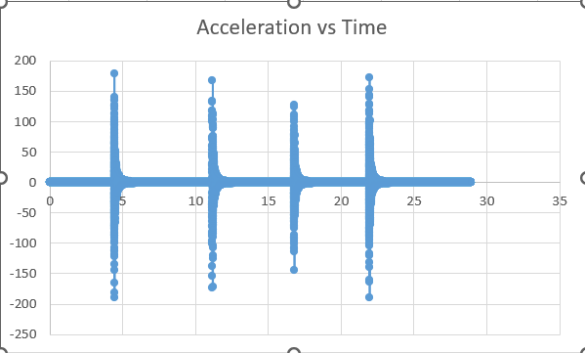
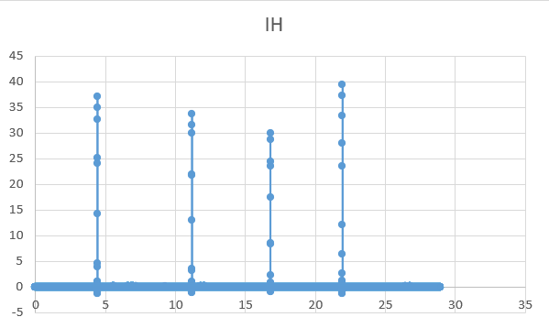
Time domain representation – 30 degree crack – point 1
Acceleration vs time
Impact Hammer vs time

Slide 3
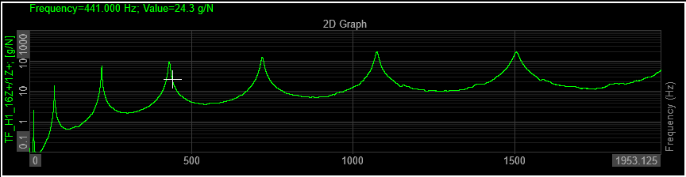
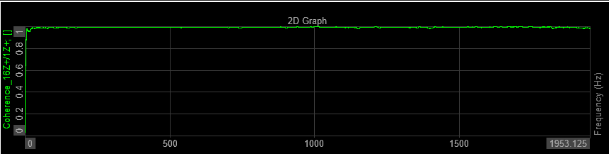
FRF Data Representation - 30 degree crack – point 1
FRF Transfer function vs Frequency
FRF Transfer function vs Frequency

Slide 4
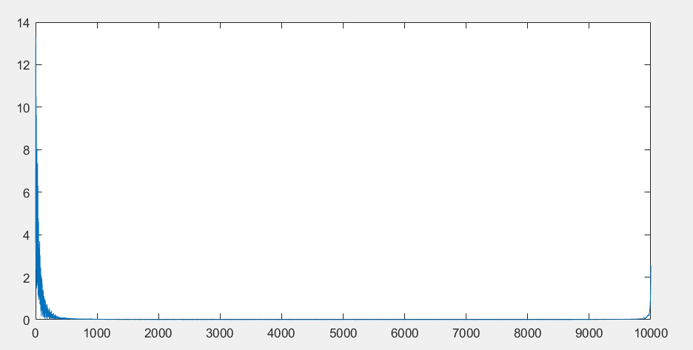
Inverse Fourier Transform of FRF- 30 degree crack-point 1
Amplitude Data of Inverse Fourier Transform of FRF after Normalization

Slide 5
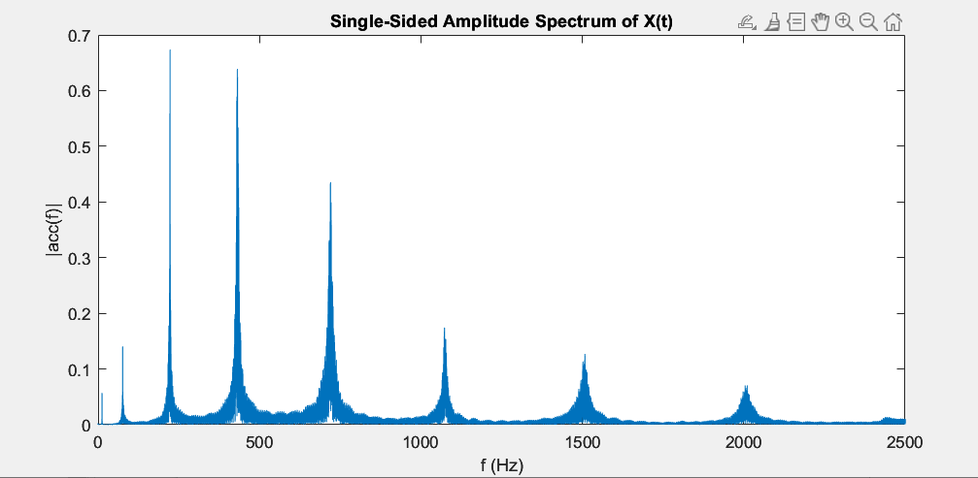
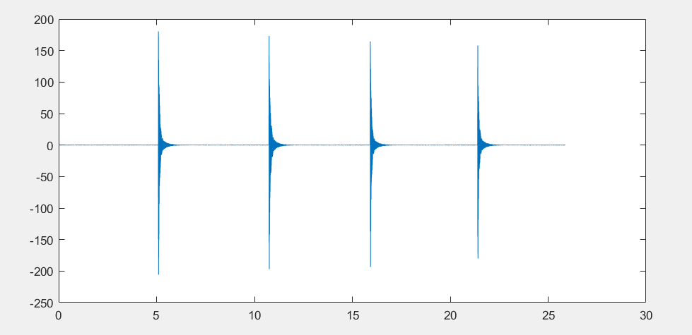
IFFT Reconstruction of FFT Acceleration Data
FFT applied to acc. Data : Norm(acc.) vs frequency
IFFT applied to acc. FFT Data : reconstructed acc. vs time

